Slide 1
Cloud computing capstone

Slide 2
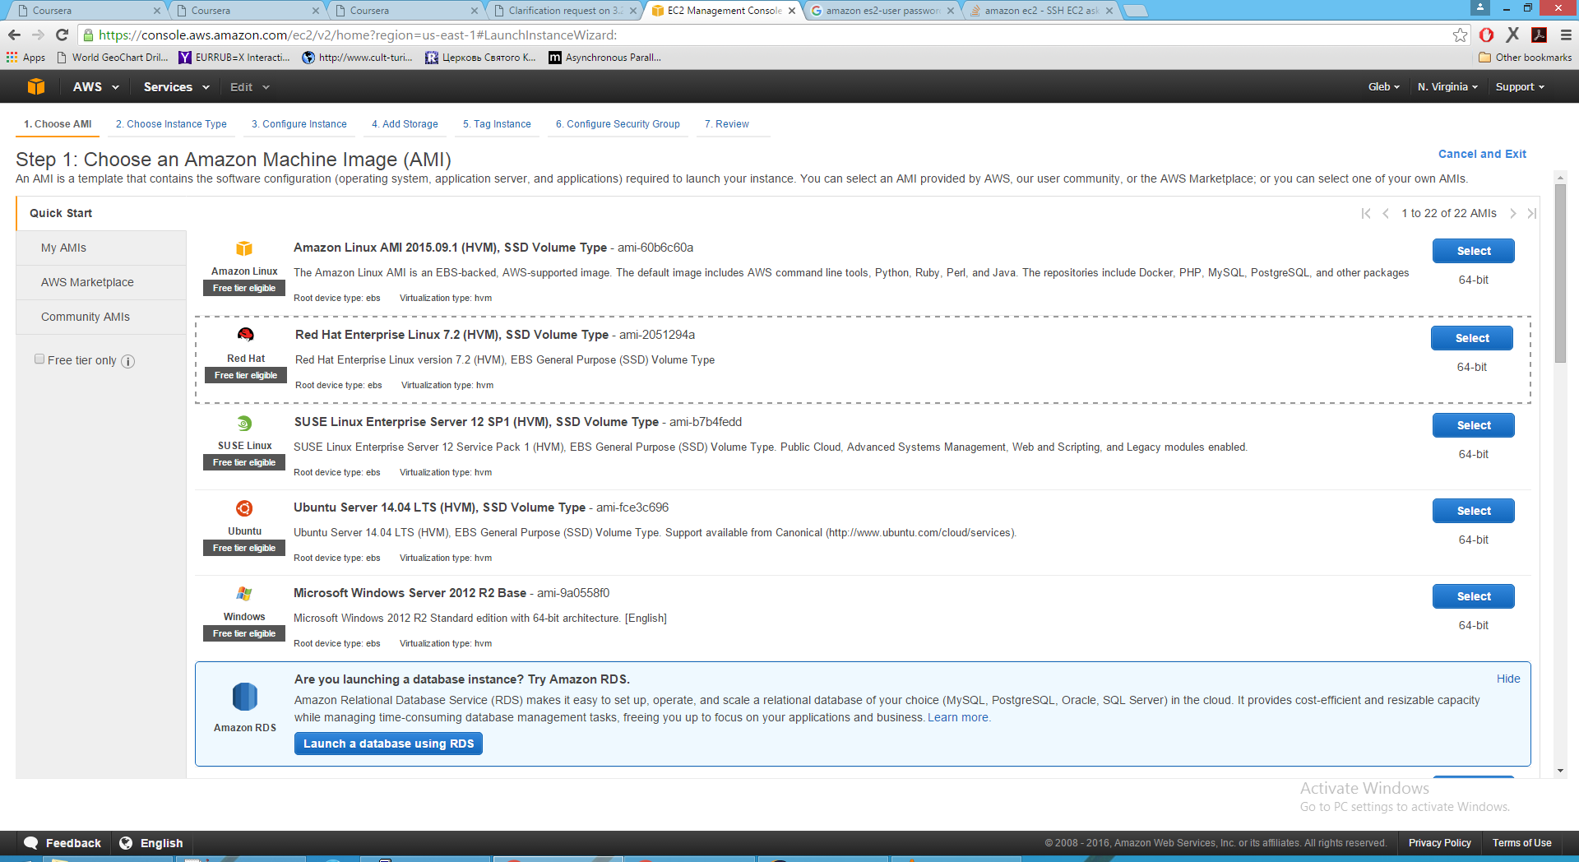
Environment setup - Amazon EC

Slide 3
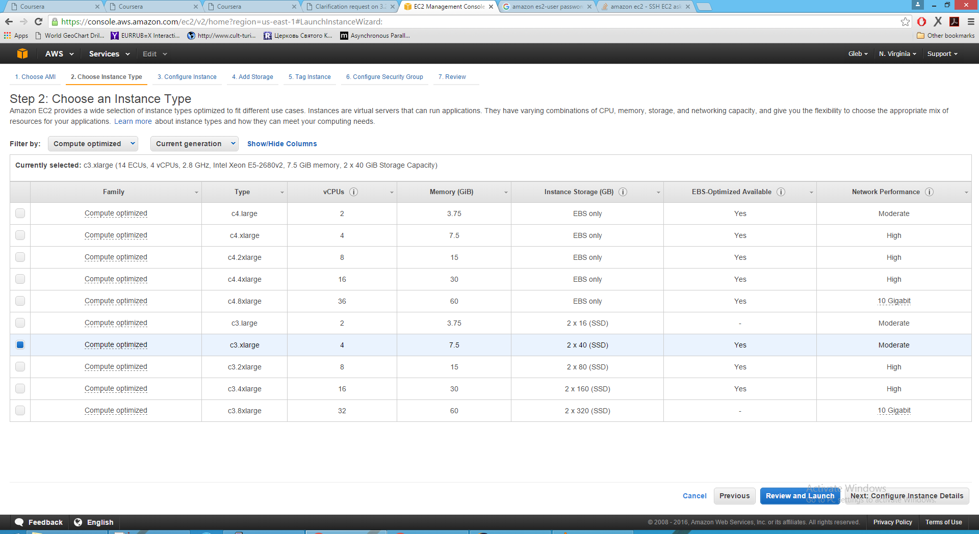
Environment setup - Amazon EC

Slide 4
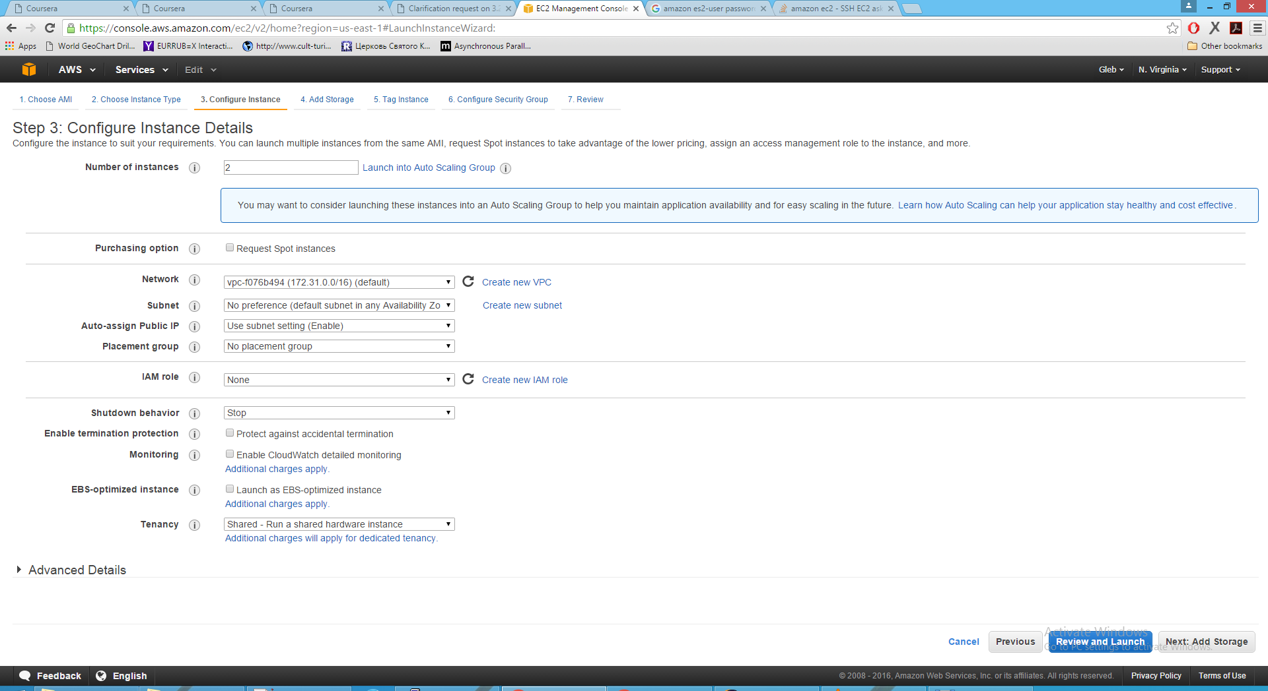
Environment setup - Amazon EC

Slide 5
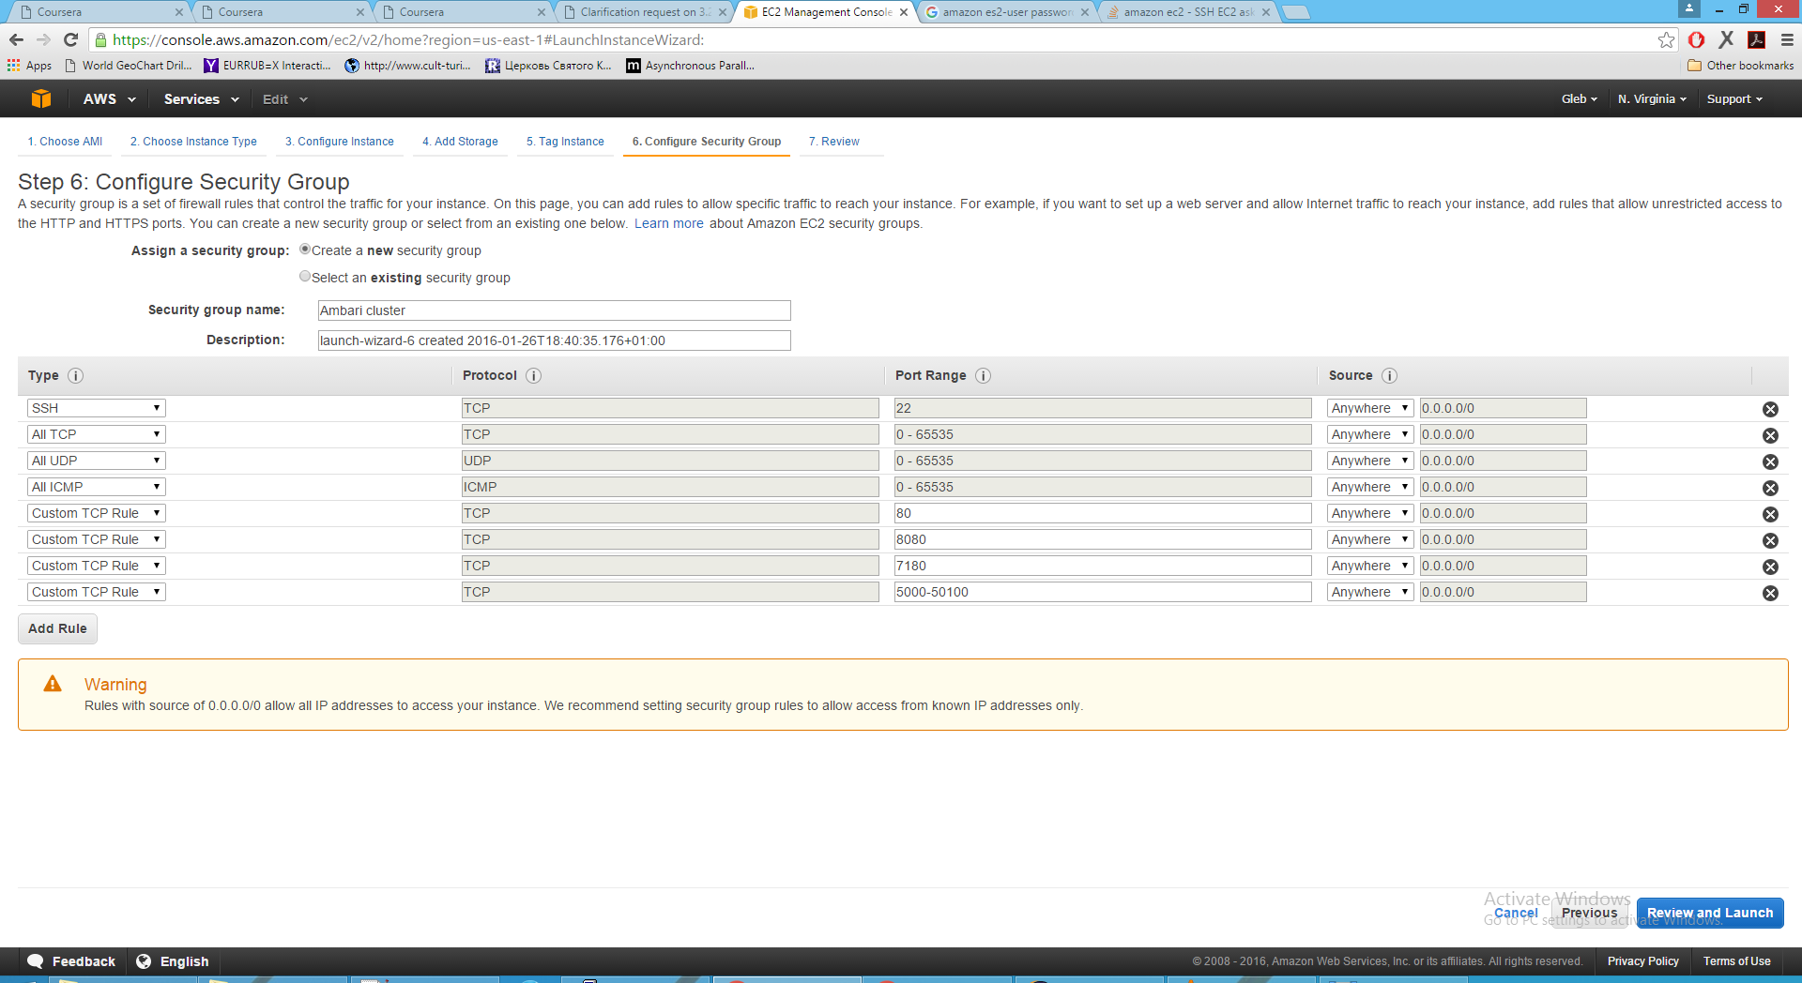
Environment setup - Amazon EC

Slide 6
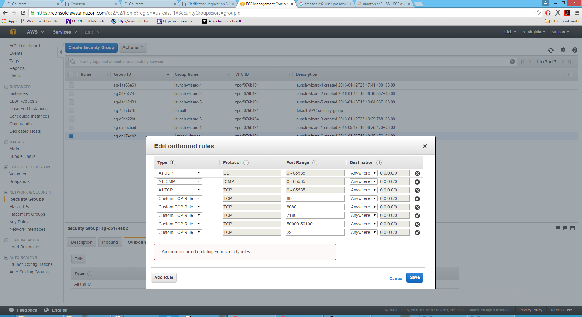
Environment setup - Amazon EC

Slide 7
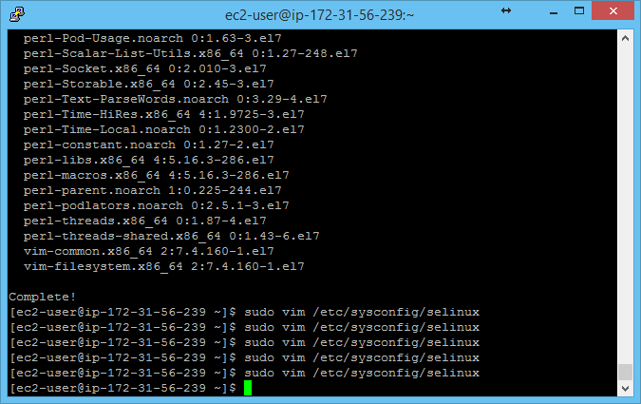
Environment setup - Cluster

Slide 8
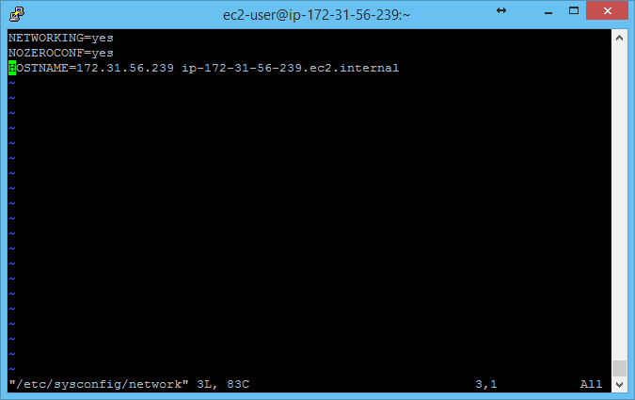
Environment setup - Cluster

Slide 9
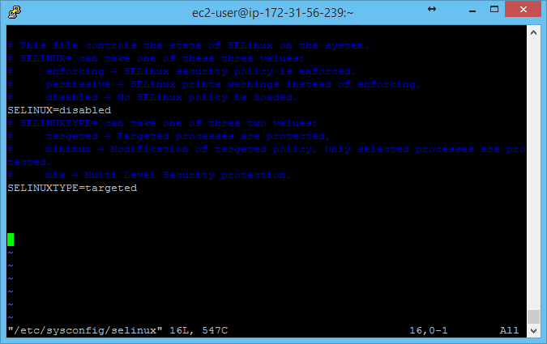
Environment setup - Cluster

Slide 10
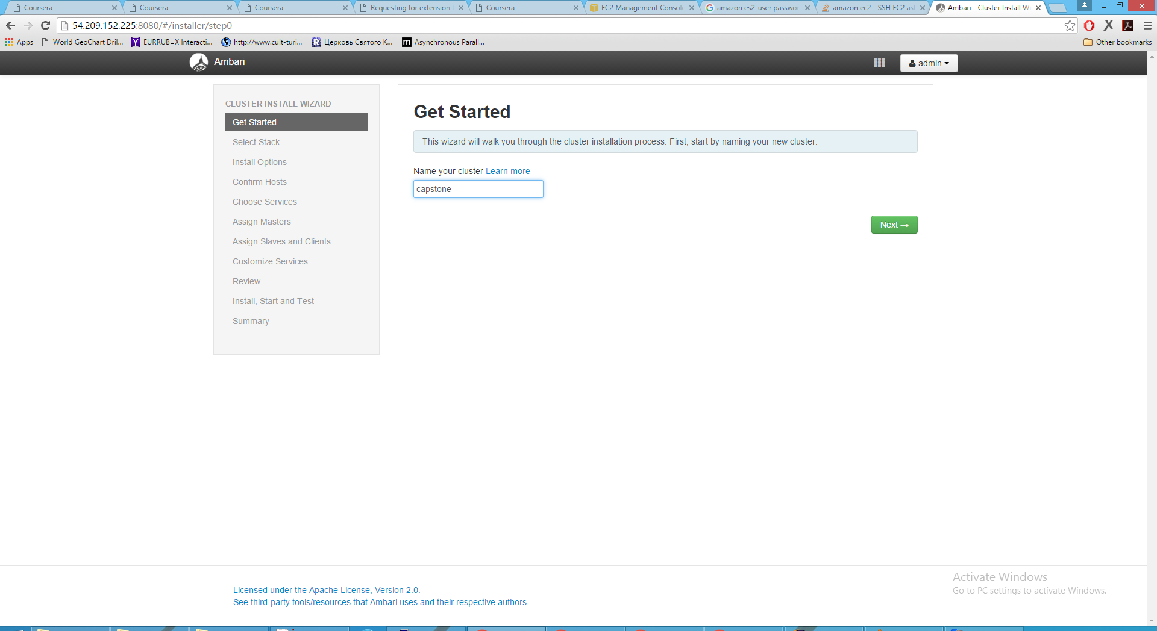
Environment setup – Ambari server

Slide 11
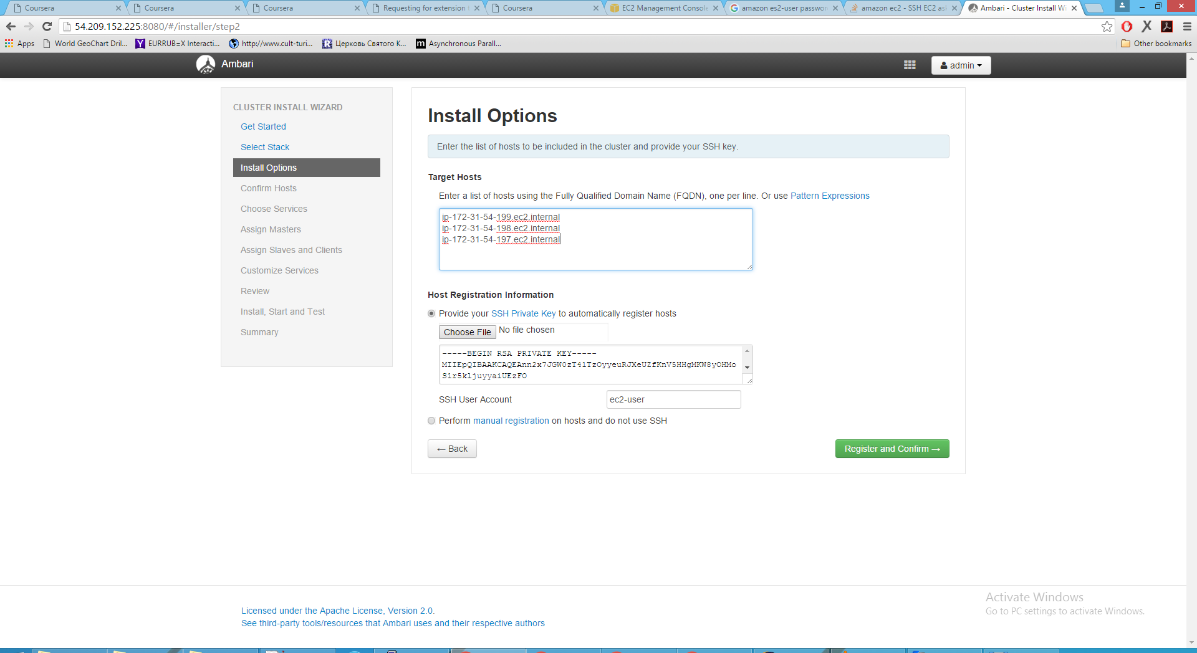
Environment setup – Ambari server

Slide 12
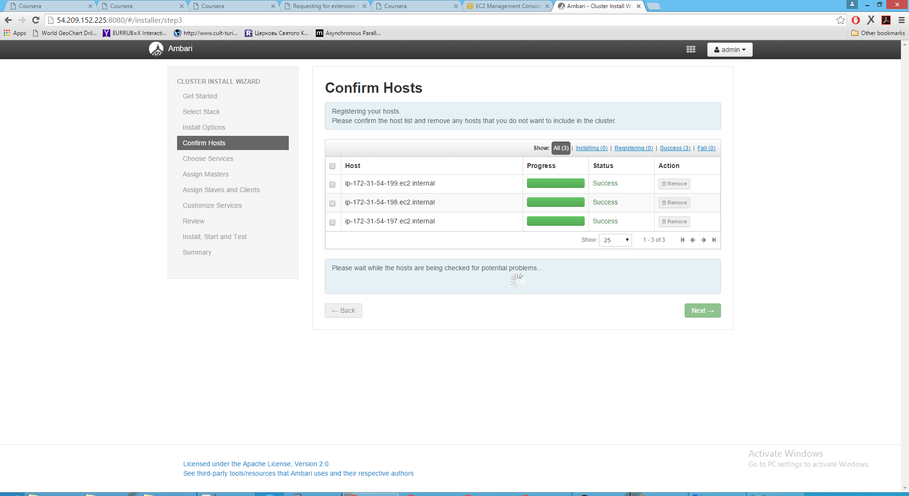
Environment setup – Ambari server

Slide 13
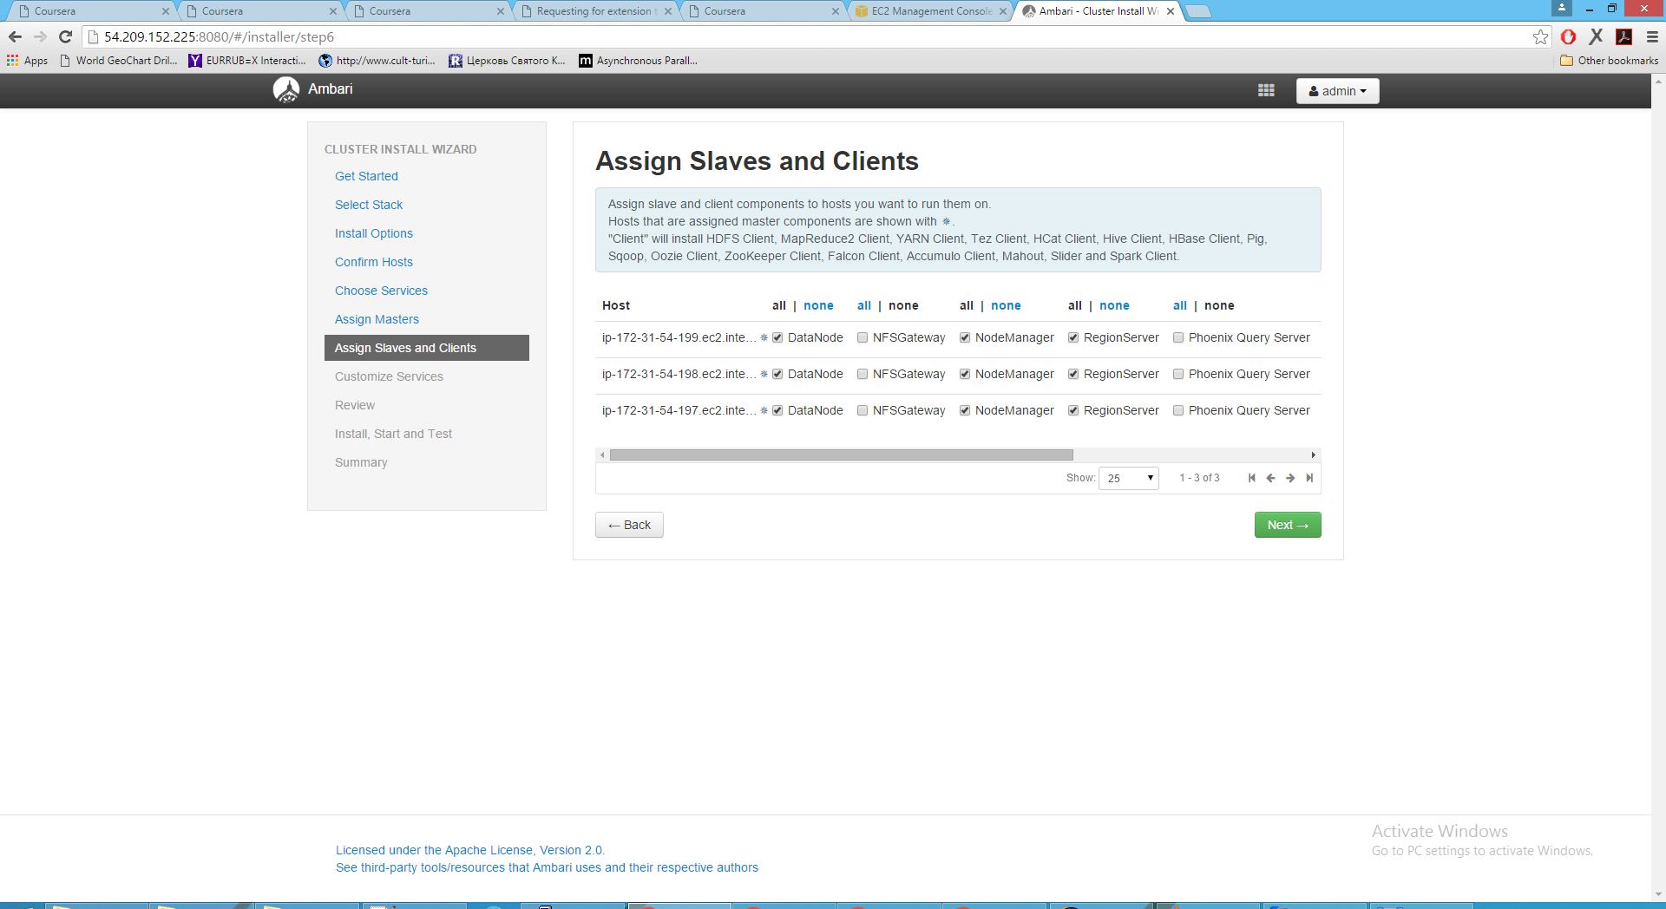
Environment setup – Ambari server

Slide 14
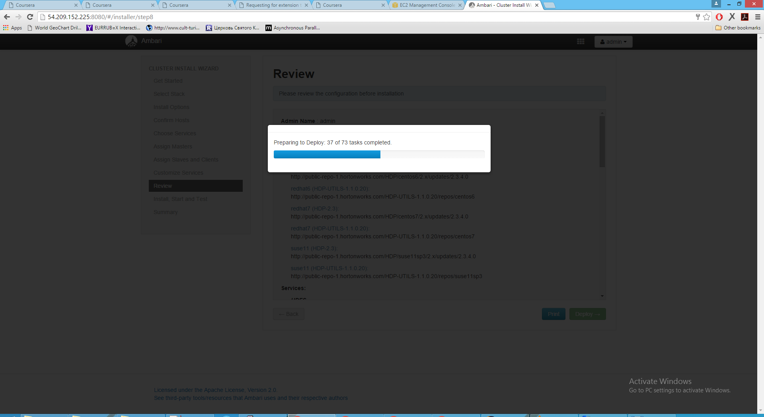
Environment setup – Ambari server

Slide 15
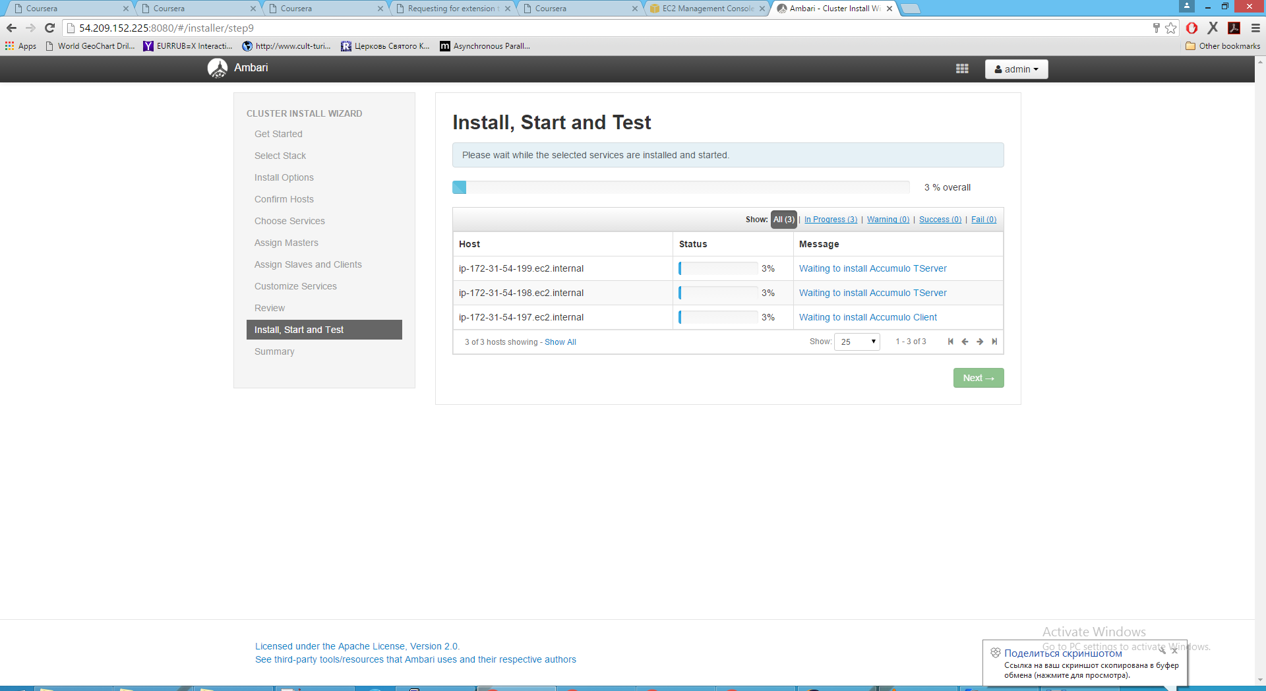
Environment setup – Ambari server

Slide 16
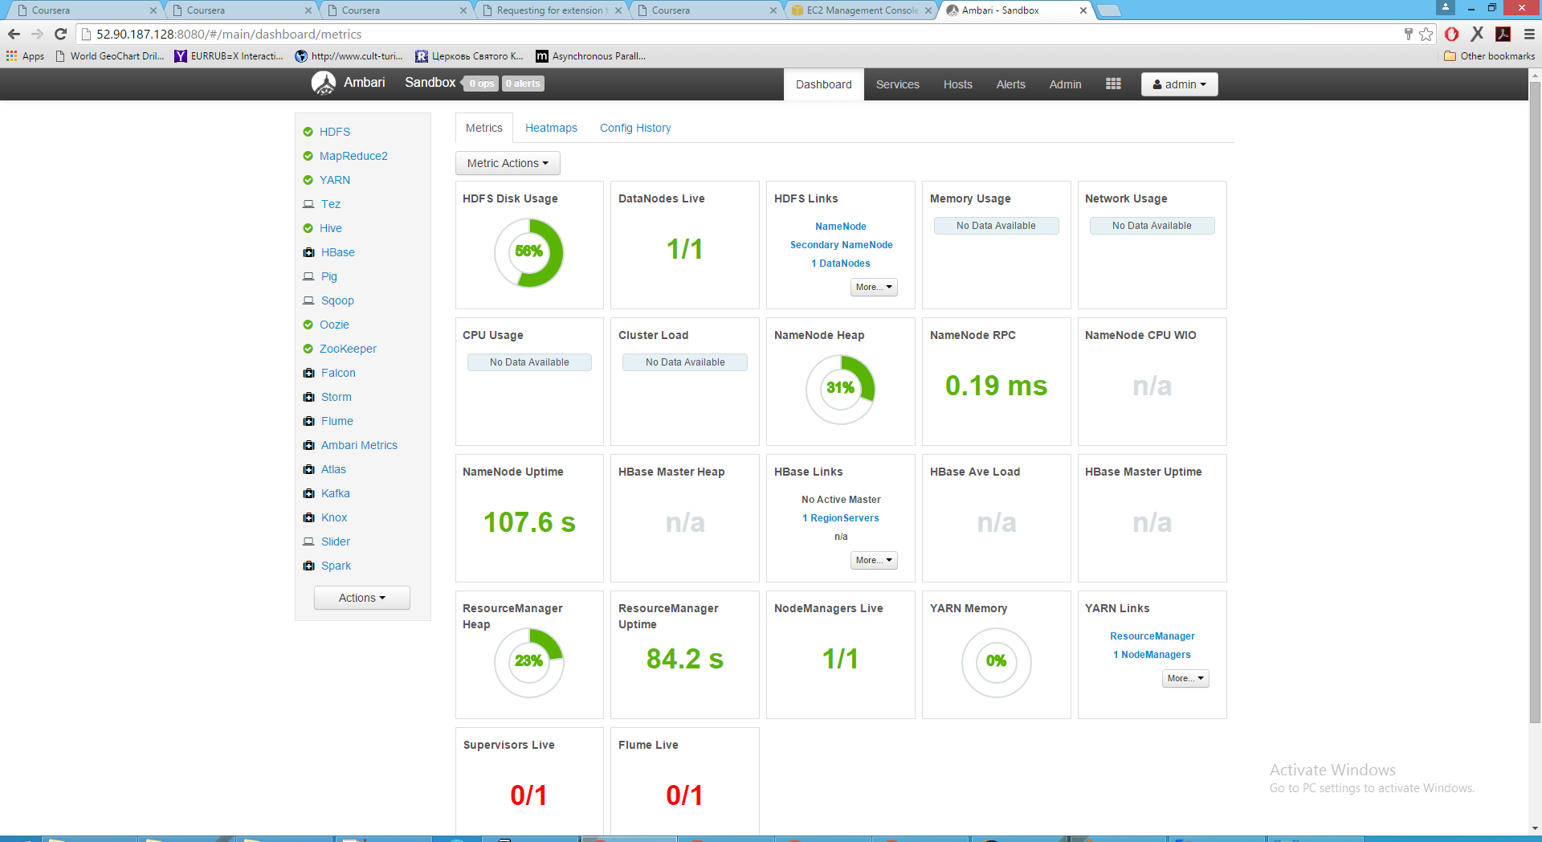
Environment setup – Ambari server

Slide 17
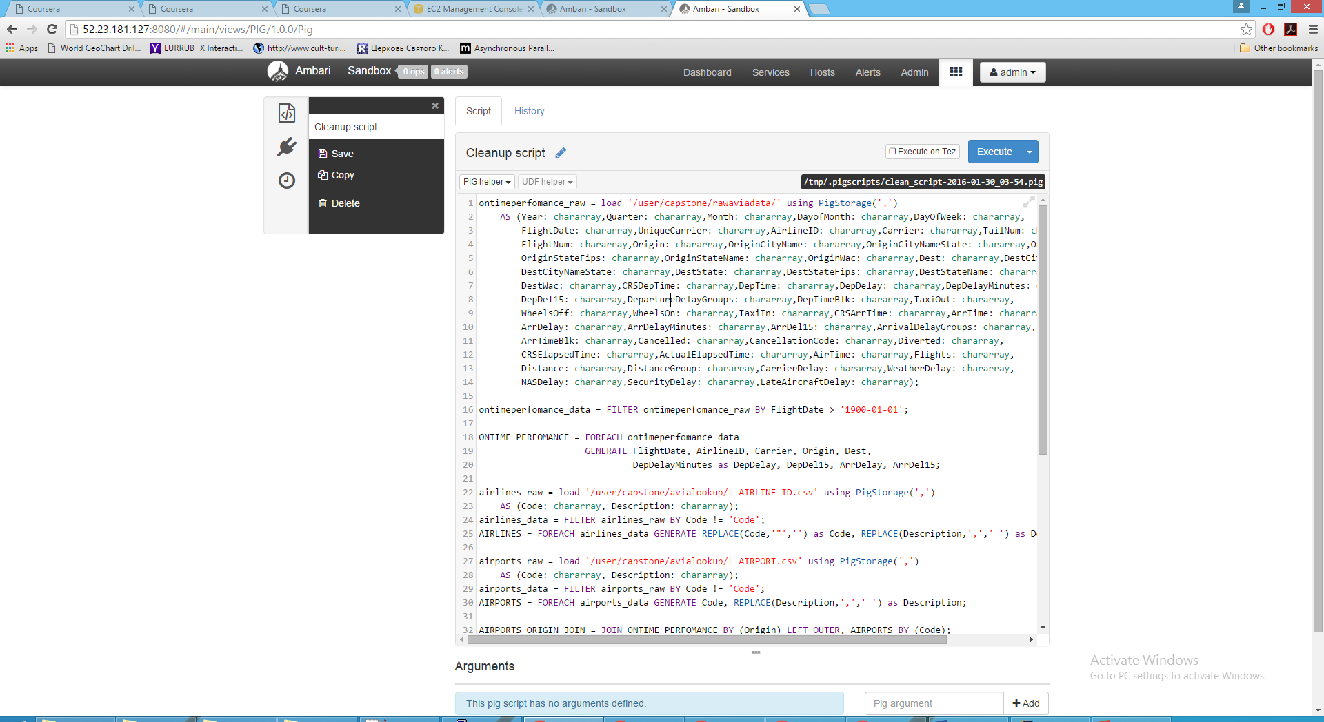
Cleanup data – PIG script

Slide 18
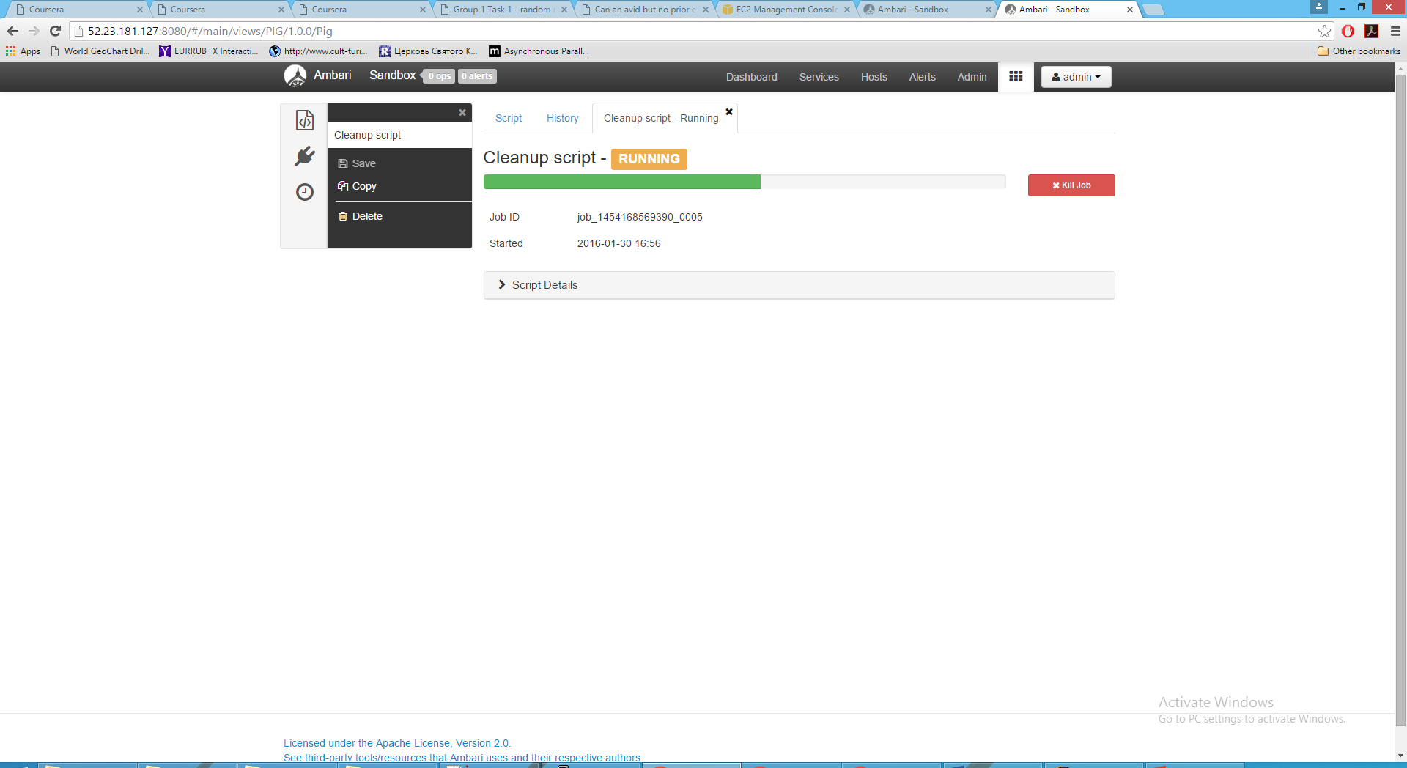
Cleanup data – PIG script

Slide 19
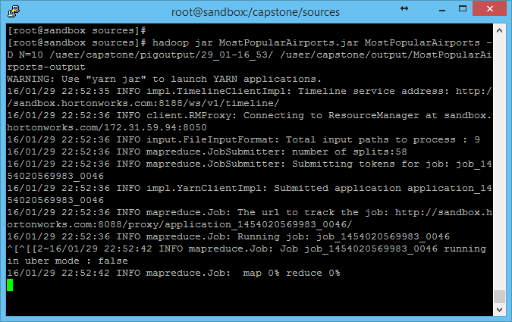
MapReduce job - Start

Slide 20
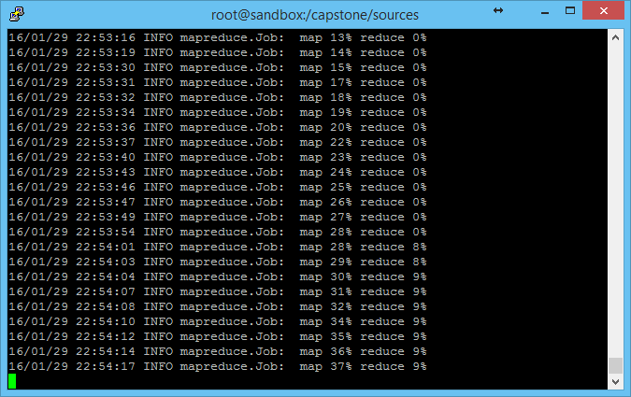
MapReduce job - Progress

Slide 21
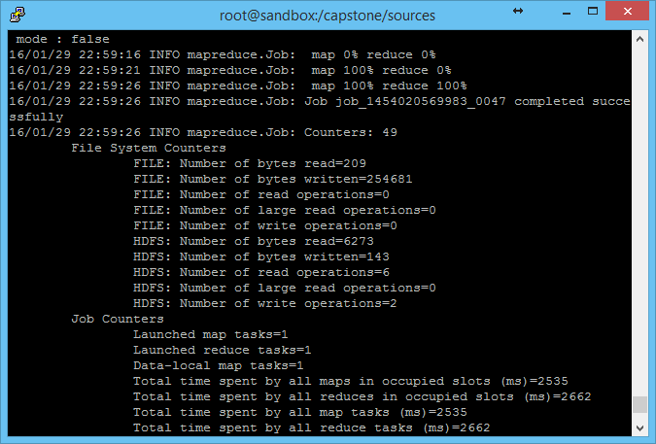
MapReduce job - Completion

Slide 22
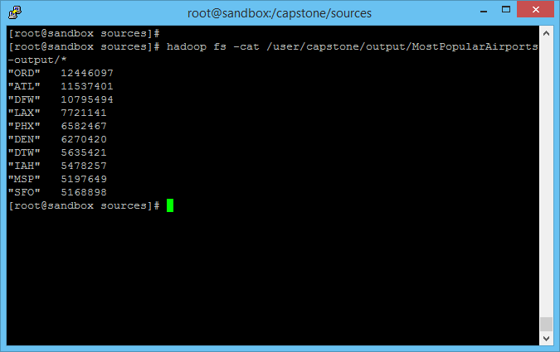
Results - Top-10 most popular airports

Slide 23
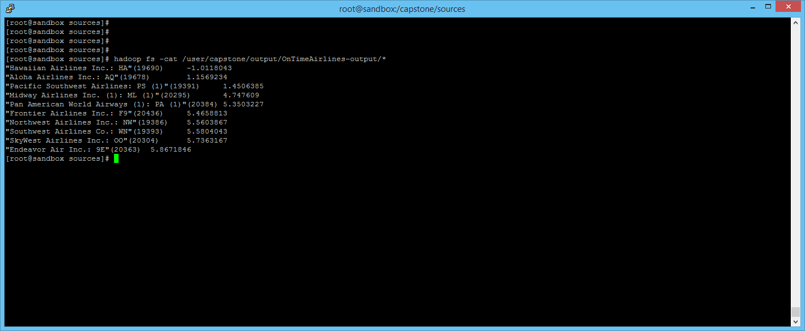
Results - Top-10 airlines with on-time perfomance

Slide 24
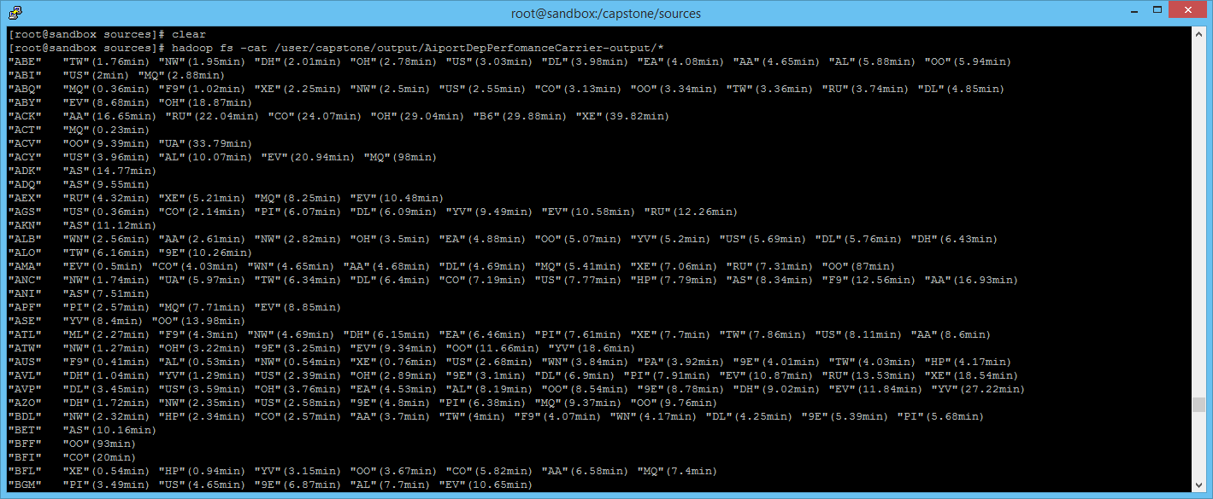
Results - Top-10 carriers with on-time departure performance for each airport

Slide 25
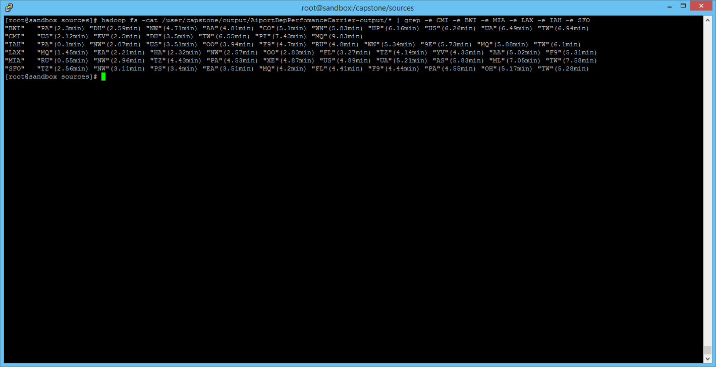
Results - Top-10 carriers with on-time departure performance for specific airports

Slide 26
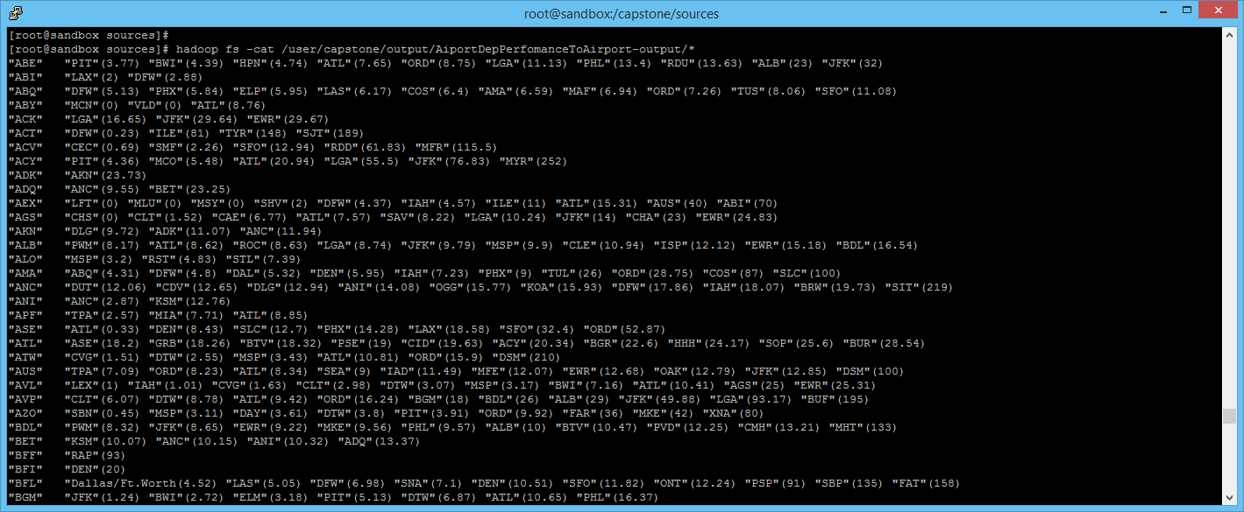
Results - Top-10 airports with on-time departure performance for each airport

Slide 27
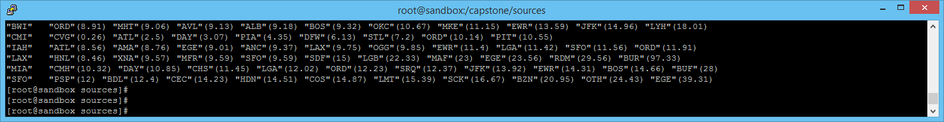
Results - Top-10 airports with on-time departure performance for specific airport

Slide 28
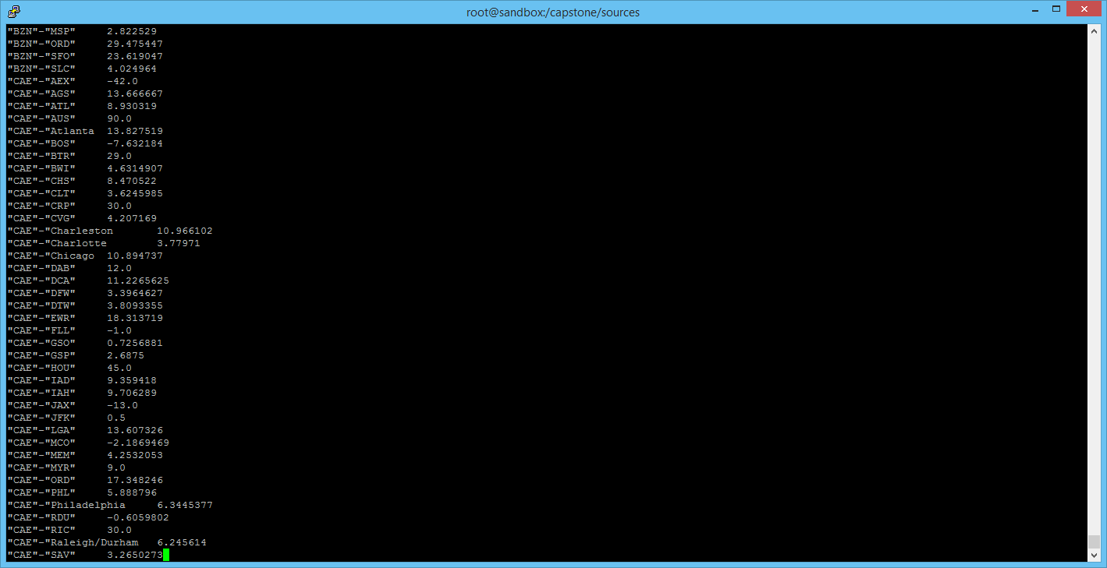
Results - Mean arrival delay for each airport pair

Slide 29
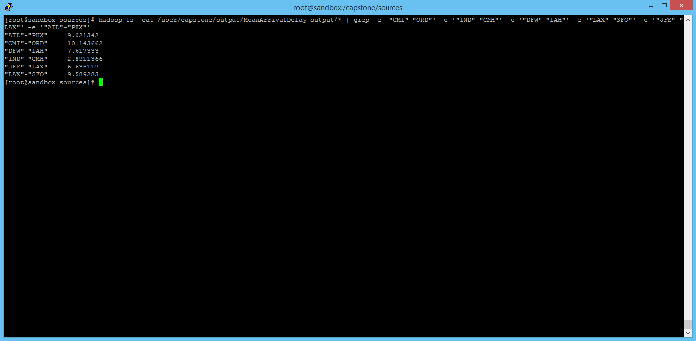
Results - Mean arrival delay for specific airport pair

Slide 30
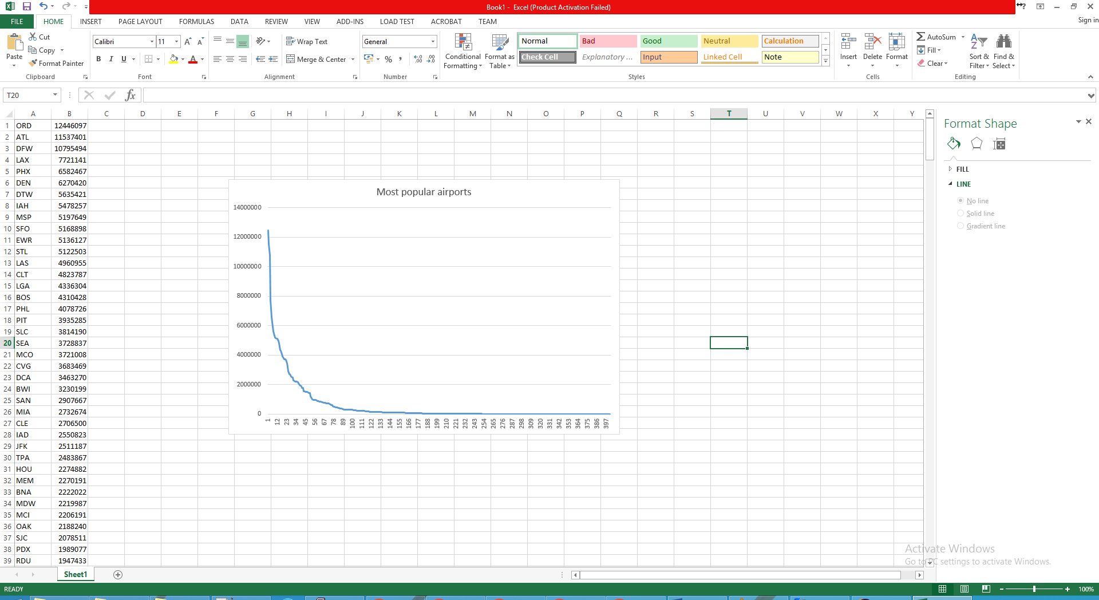
Popular airports – Linear graph

Slide 31
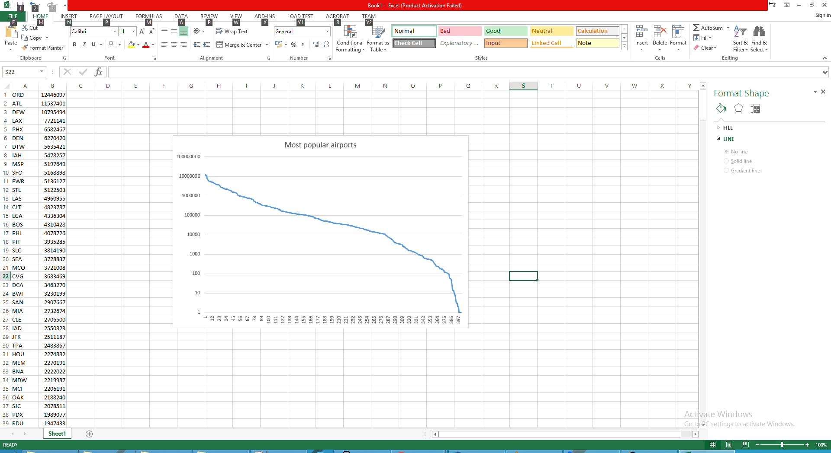
Popular airports – Log graph, Zipf destribution

Slide 32
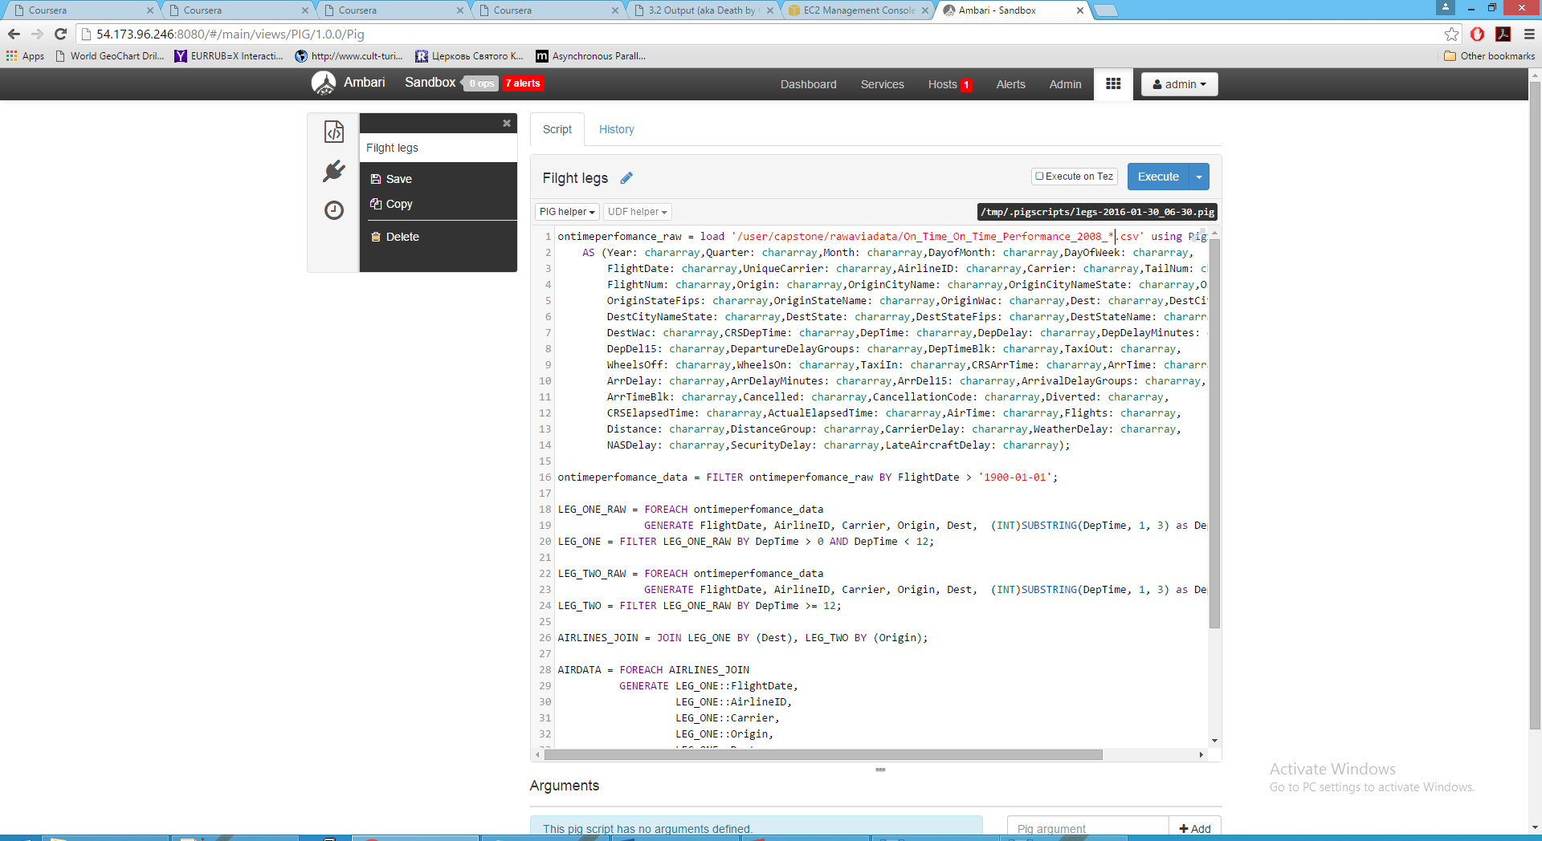
PIG script to prepare dataset with two joined flight legs

Slide 33
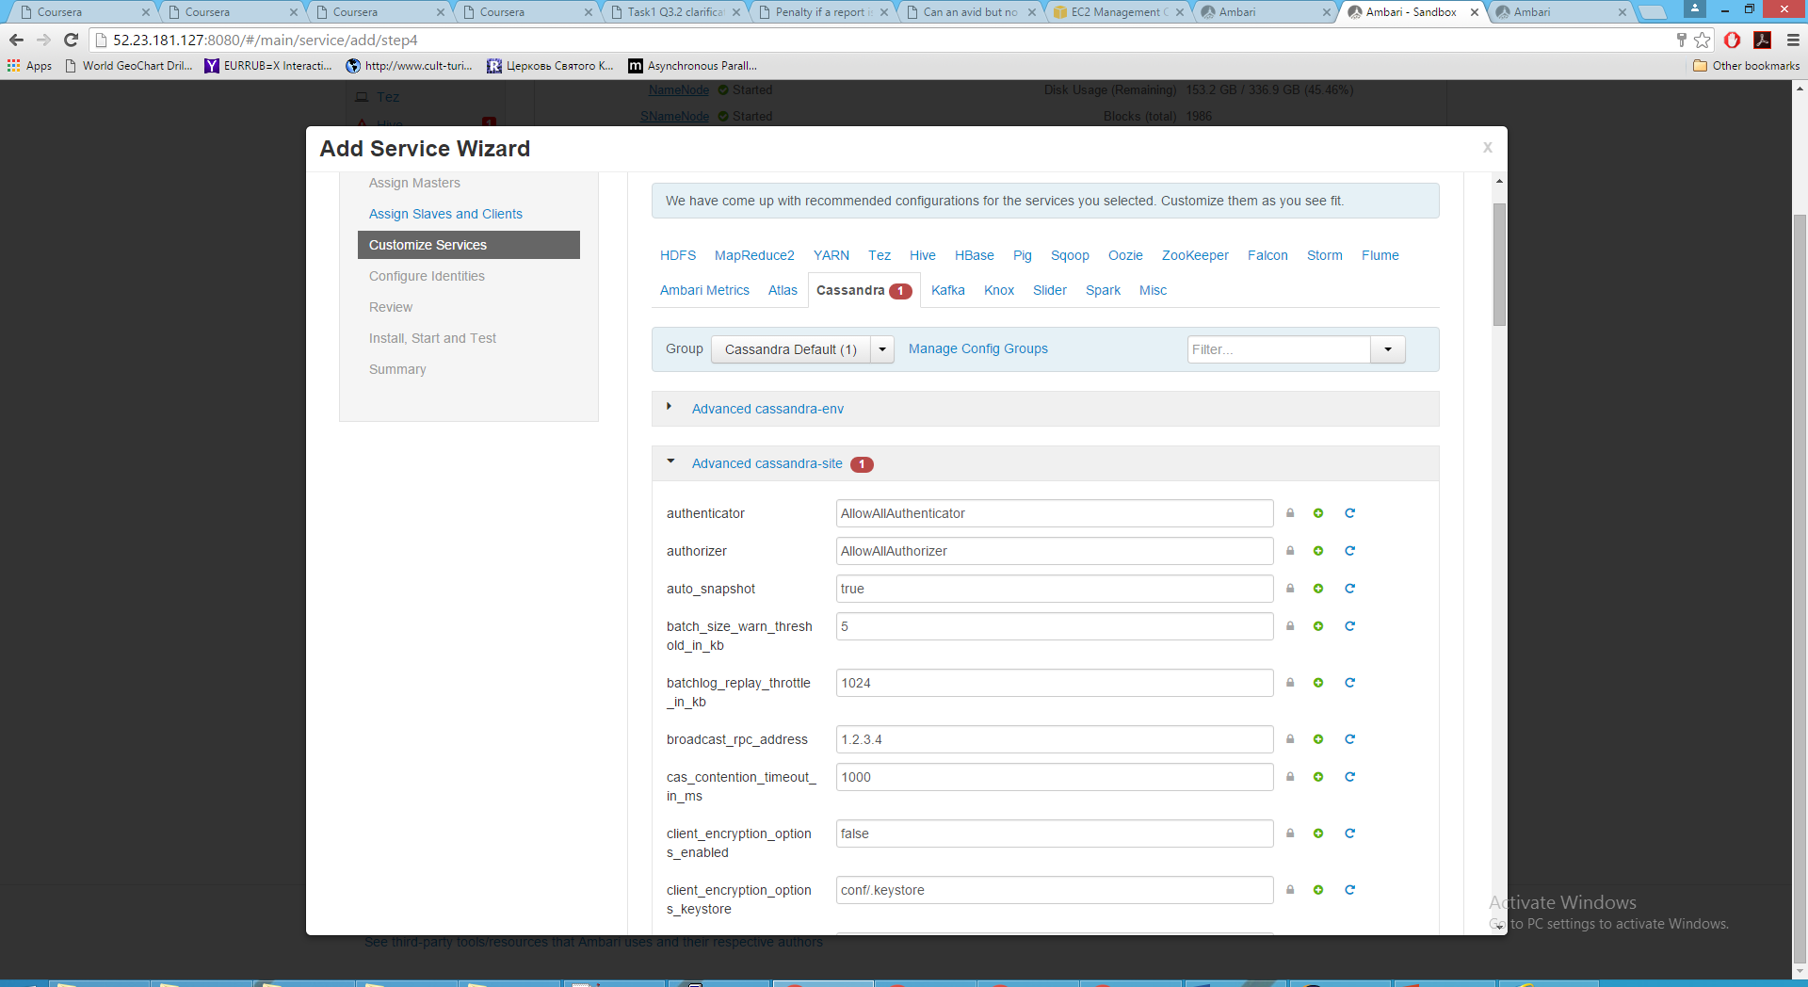
Integration – Cassandra service

Slide 34
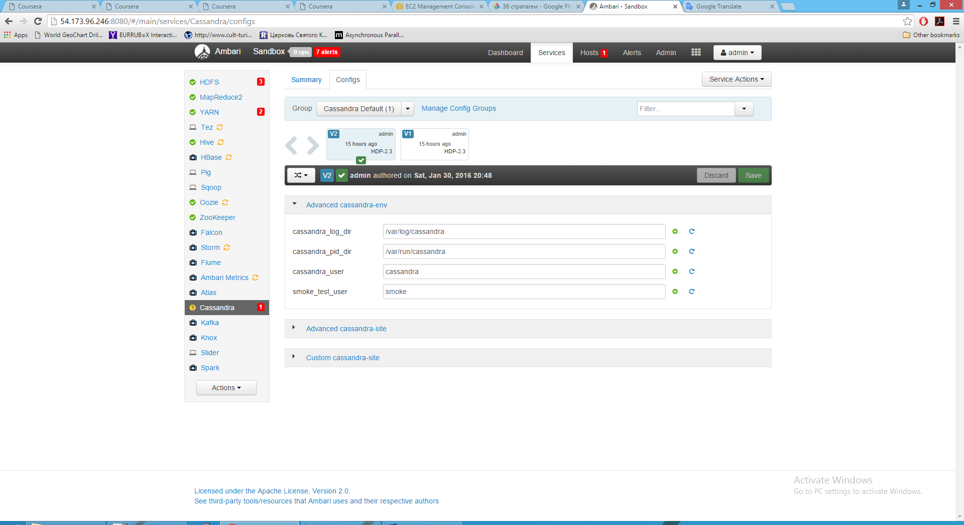
Integration – Cassandra service

Slide 35
Thank you

